Slide 1

Reverse Engineering
Protecting and Breaking the Software
Satria Ady Pradana
Reversing.ID
Revealing the Truth through Breaking Things
https://xathrya.id

Slide 2
# Whoami?
Cyber Security Consultant at Mitra Integrasi Informatika (MII)
Researcher at dracOs Dev Team
Coordinator of Reversing.ID
Member of Indonesia Honeynet Project

Slide 3
Disclaimer
This presentation is intended for educational purposes only.
Reverse engineering of copyrighted material is illegal an might cause you a direct or indirect consequence. We have no responsibility of anything you do after learning this.

Slide 4
Today’s Adventure
Fundamental of Reverse Engineering
Basic Principle
Tools
Common Practice
Common Protection

Slide 5
Revealing the Reversing
What, Why, and How?

Slide 6
The Term
Originally used in the context of mechanical engineering
Breaks down an existing object or system to its construction and then rebuild it based on new demand.
Extracting knowledge or design information from anything man-mad and reproducing it or reproduce anything based on the extracted information.

Slide 7
What it Means?
Take things apart to figure out how it works
Solving puzzle
Constantly learn new things
Thinking out of the box

Slide 8
Motivation
Interfacing
Improve documentation shortcomings
Bug Fixing
Creation of unlicensed duplicates
Repurposing
Finding security bugs
For fun!

Slide 9
The Yin Yang
Reverse engineer and developer compete each other.
Developer want to protect their intellectual property
Reverse engineer want to break the protection.
Who will win?

Slide 10
Too Broad
Software
Hardware
Radio Frequency
Protocol
Limit ourselves to reverse engineering for code and data.

Slide 11


Success Story

Slide 12

Success Story
BIOS

Slide 13
Fundamental Principle
Comprehension
Gain knowledge of basic principle or mechanics of object, the behavior, and knowledge that might related to subject.
Decomposition
Breaking down the system into its structure and gain insight about inherent structure and properties of the component that make the system.
Reconstruction
Reform or reconstruct the components based on need.

Slide 14
Common Practice
Some popular and commonly used practice or operation

Slide 15
Resource Modification (Modding)
Control Flow Bypass
Code Caving

Slide 16
Resource Modification (Modding)
Modify the resource of application
Icon
Menu
Layout
Sprite

Slide 17
Control Flow Bypass
Alter program flow
Force program to takes (or leaves) intended action.
Jump over the protection mechanism

Slide 18
Code Caving
Writing code to specific region of application (or process’ memory)
Fast and easy
No need for source
In conjunction of Function Trampoline.

Slide 19
Basic Knowledge

Slide 20
The Language
Depend on the target of reversing.
Each programming languages might have unique trait or characteristic.
Channel in Go
Two classes of programming language: native, interpreted.

Slide 21
Assembly
Primitive of Processors operations
Complex operation is decomposed to various instructions
Constrained by processors’ architecture

Slide 22
The Executable Format
Application has a format.
Identify by magic number.
Structured and has some sections for data, code, resource, etc.
Function might be provided by foreign module (ex: DLL), list of imported function is maintained.

Slide 23
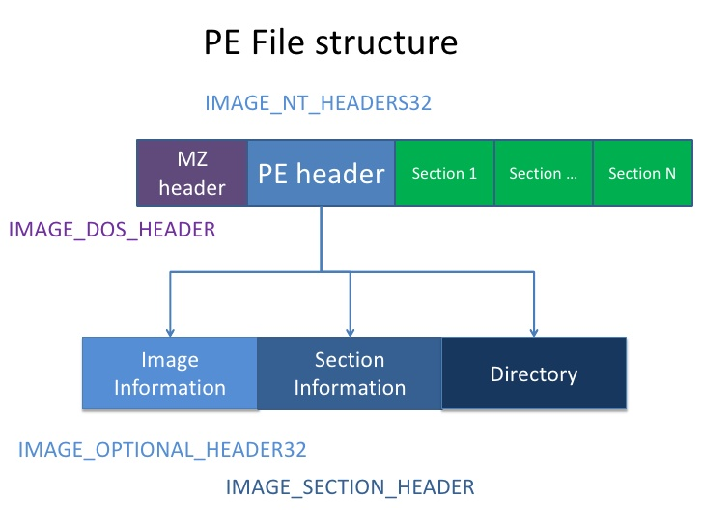

Slide 24
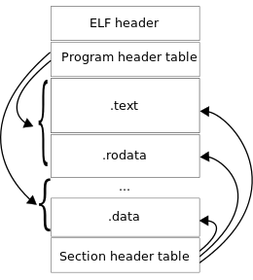

Slide 25
Design Pattern
Software is divided into conceptual module and working together.
Repeatable solution to a commonly occurring problem in a software design.

Slide 26
Common Code Base
Library
Framework

Slide 27
Common Tools
Breaking the system to fine-grain components

Slide 28
Hex Editor
Disassembler
Debugger
Resource Editor

Slide 29
Hex Editor
Display the content of file as collection of hex formatted-data and modify part of them.
Find pattern and occurrence.

Slide 30
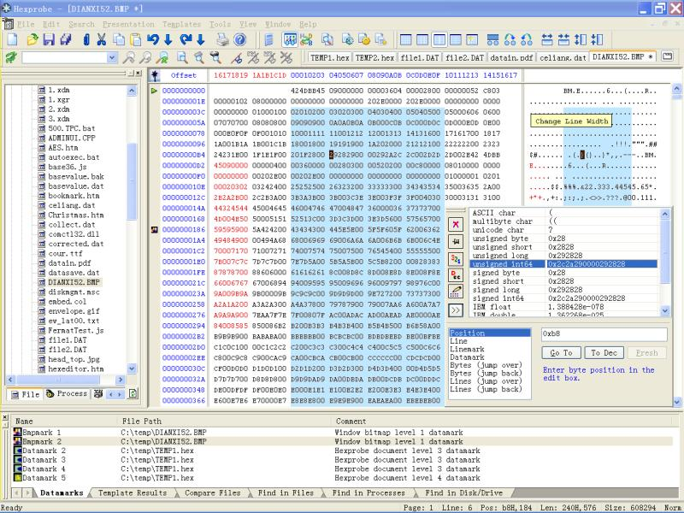

Slide 31
Disassembler
Transform stream of hex bytes to its assembly representation.
Resolve data and resource, referred by the code.

Slide 32
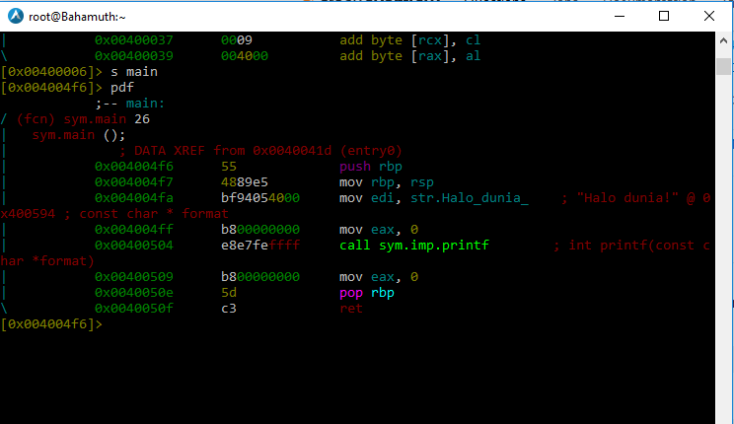

Slide 33
Debugger
Test or debug other (target) program
Examine program condition at runtime.
Modify code or data section.
Modify CPU state
Alter control flow

Slide 34
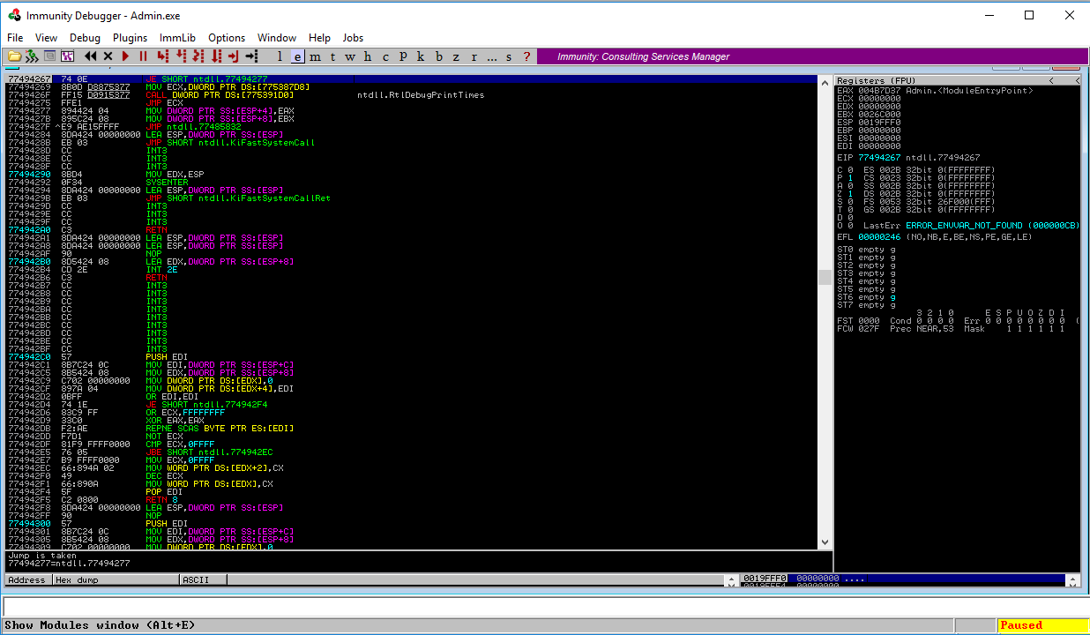

Slide 35
Comprehension
Gaining the knowledge related to the target

Slide 36
Approach of Learning the Subject
Background checking
What programming language
What packer used
What library might be used
Static Analysis
Dynamic Analysis

Slide 37
Decomposition
Breaking the structure of system to its fine-grained components

Slide 38
Get the global view of program flows
Graph
Grouping

Slide 39
Reconstruction
Creating the system based on the extracted knowledge

Slide 40
anything

Slide 41
Common Protection

Slide 42
Obfuscation
Self debug
Section Corruption
Packer
Encryption
Virtual Machine

Slide 43
Advance Stuffs

Slide 44
Dynamic Binary Instrumentation
Symbolic Execution

Slide 45
References
http://www.openrce.org/articles/
http://vxheaven.org/
https://www.reddit.com/r/reverseengineering

